Slide 1
Implementing a Robust
Multi-Factor Authentication (MFA) System
Enterprise BFSI Environment
Assessment • Solution Design • Implementation Plan • Security Operations
Active Directory | NPS/RADIUS | TOTP | Email OTP | SMS OTP

Slide 2
Executive Summary
OVERVIEW
Design a robust enterprise MFA capability that strengthens authentication while minimizing disruption to users.
Assess the existing identity and remote-access foundation and identify authentication gaps.
Demonstrate selected MFA workflows in a controlled lab and define enterprise-ready integration patterns.
Provide implementation, policy, monitoring, incident-response, training and rollout guidance.
Use a clear distinction between lab-tested capabilities and proposed enterprise controls.
Core principle: strong authentication + usable recovery + centralized monitoring + controlled rollout.

Slide 3
Business Scenario & Security Objectives
OVERVIEW
Enterprise Scenario
A multinational BFSI organization requires stronger protection for enterprise resources.
Authentication must support employees, remote users and privileged users.
Solution should integrate with existing identity, SSO and remote-access infrastructure.
Security Objectives
Reduce unauthorized access and credential compromise.
Support adaptive verification and multiple authentication factors.
Maintain usability and accessibility.
Enable centralized monitoring and incident response.
Support compliance and auditability.

Slide 4
Project Scope & Coverage
OVERVIEW
Assessment: current authentication mechanisms, configuration and security gaps.
Solution design: MFA methods, architecture, integration and user experience.
Implementation planning: pilot, phased rollout and operational readiness.
Practical scope: AD/NPS/RADIUS foundation plus MFA method demonstrations.
Enterprise design scope: biometrics, hardware tokens, SSO, VPN, monitoring, incident response, compliance and awareness.
Deliverables: assessment, design, implementation plan, configuration guides, policy/compliance documentation and monitoring/IR plan.

Slide 5




Requirement-to-Deliverable Mapping
ASSESSMENT
Requirement
Planned Deliverable
PPT Coverage
Assessment & Planning
Current-state assessment + requirements
Included
MFA Solution Design
Methods, integration, UX, architecture
Included
Implementation Plan
Pilot + phased rollout
Included
MFA Configuration Guides
OTP, authenticator, biometrics, token
Included
SSO / VPN Integration
Architecture + configuration plan
Included
Security & Compliance
Policies + compliance checklist
Included
Monitoring / IR
Monitoring controls + incident drill design
Included
Training / Awareness
User training + awareness campaign
Included

Slide 6
Current-State Authentication Assessment
ASSESSED
ASSESSMENT
Windows Server 2022 Standard Evaluation 2009 identified as the lab server platform.
Active Directory domain: finsecure.local; NetBIOS: FINSECURE; domain mode: Windows2016Domain.
Test account: testuser — enabled, not locked, not password-expired.
NPS/Network Policy and Access Services installed; IAS service running automatically.
RADIUS authentication configured on UDP 1812; accounting on UDP 1813.
Kali configured as a RADIUS client at 192.168.64.128.

Slide 7
Identity, Group & Password Controls
ASSESSMENT
Identity & Authorization
User: testuser
UPN: testuser@finsecure.local
Security group: NPS-RADIUS-Users
NPS policy: kali RADIUS - Allow Test Users
Policy state: Enabled; processing order: 1
Password Policy Observed
Minimum length: 7 characters
Complexity: Enabled
Maximum age: 42 days
Minimum age: 1 day
Password history: 24 passwords

Slide 8
Authentication Gaps & Risk Assessment
ASSESSMENT
Password-only authentication is vulnerable to phishing, credential reuse and password theft.
Remote access requires stronger verification than a single reusable secret.
Fallback channels can become attack paths if recovery controls are weak.
Biometric and hardware-token capabilities require compatible endpoint hardware and enterprise policy.
Centralized monitoring is required to detect repeated failures and suspicious MFA activity.
User training is necessary to reduce MFA fatigue, social engineering and unsafe recovery behavior.

Slide 9


Proposed Enterprise MFA Architecture
SOLUTION DESIGN
User / Device
SSO / VPN
Identity Provider
MFA Policy
AD / Directory
Application / Network
Policy layer selects the appropriate factor based on risk, user role, device and application sensitivity.

Slide 10
MFA Factor Strategy
SOLUTION DESIGN
Primary / Preferred
Authenticator-app TOTP for broad compatibility.
Platform biometrics / Windows Hello for Business on supported endpoints.
FIDO2 / passkeys / security keys for phishing-resistant authentication.
Stronger requirements for privileged and high-risk access.
Fallback / Recovery
Email OTP for controlled fallback in the lab design.
SMS OTP as a lower-assurance fallback / simulation.
Documented recovery and re-enrollment process.
Break-glass accounts protected and monitored.

Slide 11


AD + NPS/RADIUS Integration
SOLUTION DESIGN
Kali / VPN
RADIUS 1812
NPS Policy
Active Directory
Access-Accept / Reject
RADIUS client: Kali; shared secret configured in the lab.
NPS policy restricts access using the NPS-RADIUS-Users group.
Successful lab result: radtest returned Access-Accept for testuser.
The architecture can be reused by compatible VPN/remote-access gateways.

Slide 12
Practical Validation: RADIUS Foundation
COMPLETED
IMPLEMENTATION
AD account status verified successfully.
NPS client and policy configuration verified.
Authentication ports verified: 1812 / 1813.
radtest from Kali returned Access-Accept.
Returned attributes included Framed-Protocol = PPP and Service-Type = Framed-User.
Evidence placeholder: insert screenshot of the successful radtest Access-Accept output.

Slide 13
Authenticator App – TOTP
COMPLETED
IMPLEMENTATION
Secret Enrollment
Authenticator App
6-digit TOTP
Server Verification
Access
PyOTP was installed and successfully generated time-based codes.
Microsoft Authenticator was used for the authenticator-app workflow.
OTP verification was successfully completed.
Recommended production enhancement: prefer phishing-resistant MFA where feasible.

Slide 14
Email OTP – Lab Demonstration
COMPLETED
IMPLEMENTATION
Generate OTP
SMTP Client
aiosmtpd Capture
User Receives Code
Verify
Email subject used: FINSECURE MFA - Email OTP.
Lab message contained a six-digit verification code.
OTP expiry configured for 5 minutes.
OTP was received in the local SMTP capture and verification succeeded.

Slide 15
SMS OTP – Lab Simulation
SIMULATED
IMPLEMENTATION
Generate OTP
SMS Gateway (Sim.)
User Receives Code
Verify
Access
Six-digit OTP workflow was successfully verified.
5-minute expiry used in the lab.
No real telecom SMS delivery was performed.
Production recommendation: treat SMS as lower assurance and prefer stronger factors where available.

Slide 16
Biometric Authentication – Evaluation
EVALUATED
IMPLEMENTATION
Observed on Windows 11
ELAN WBF Fingerprint Sensor — device status OK.
HP Wide Vision HD Camera — device status OK.
Hardware/drivers were detected successfully.
Windows Hello Assessment
NgcSet: NO.
AzureAdJoined: NO; DomainJoined: NO in dsregcmd status.
PolicyEnabled: NO; PreReqResult: WillNotProvision.
Conclusion: hardware present, but Windows Hello provisioning was unavailable in the lab configuration.

Slide 17
Hardware Token / FIDO2 Strategy
DESIGN
SOLUTION DESIGN
Recommended for privileged administrators and high-risk access: FIDO2 security keys / passkeys.
Examples include YubiKey-class security keys.
Enrollment should bind the authenticator to the enterprise identity with controlled registration.
Authentication should use phishing-resistant challenge-response rather than reusable passwords.
No physical FIDO2 token was available in the lab; therefore no live hardware-token test is claimed.
Evidence status: Design and deployment procedure included; physical device testing remains a lab limitation.

Slide 18
Single Sign-On (SSO) Integration
DESIGN
SOLUTION DESIGN
User
SSO Portal
Identity Provider
MFA Challenge
Application Session
Centralize authentication and MFA policy through the enterprise SSO layer.
Use directory-backed identity and conditional access/risk controls.
Apply stronger MFA for privileged, remote and sensitive applications.
Current lab did not deploy a full SSO platform; this slide defines the target integration.

Slide 19
VPN & Remote Access MFA
DESIGN
SOLUTION DESIGN
Remote User
VPN Gateway
RADIUS / Identity
MFA
Internal Access
Require MFA before granting remote connectivity.
Use RADIUS integration where supported by the VPN gateway.
Apply stronger controls to privileged and high-risk remote sessions.
RADIUS foundation was tested; a production VPN gateway was not deployed in the current lab.

Slide 20
Security, Usability & Accessibility
SOLUTION DESIGN
Security
Risk-based MFA reduces unnecessary prompts.
Phishing-resistant methods should be preferred.
Recovery must not bypass strong authentication.
Privileged users receive stronger requirements.
User Experience & Accessibility
Simple enrollment and clear prompts.
Accessible alternatives for users unable to use biometrics.
Multiple approved recovery options.
Training and help-desk procedures for lost devices/tokens.

Slide 21
Implementation Plan – Pilot to Enterprise
IMPLEMENTATION PLAN
Assess
Pilot
Controlled Rollout
Enterprise Rollout
Optimize
Pilot with a small virtual-user group and IT/security users.
Measure enrollment success, failures, support requests and user feedback.
Expand to business-critical and remote users before enterprise-wide rollout.
Maintain rollback, recovery and break-glass procedures.

Slide 22
MFA Security Policy Framework
SECURITY & COMPLIANCE
Enrollment: approved authenticators, identity verification and registration.
Authentication: factor requirements based on user role, application sensitivity and risk.
Recovery: controlled reset, token revocation and re-enrollment.
Privileged access: stronger, phishing-resistant MFA where possible.
Logging: record successful/failed authentication and MFA lifecycle events.
Exceptions: documented, time-limited and approved by security management.

Slide 23






Compliance & Governance Mapping
SECURITY & COMPLIANCE
Control Area
Requirement
Evidence / Treatment
Access control
MFA + least privilege
AD/NPS + MFA design
Authentication
Strong multi-factor verification
TOTP + proposed FIDO2/biometric
Auditability
Authentication event logging
NPS/RADIUS + monitoring design
Incident management
Defined detection/response
IR workflow
Privacy
Limit and protect identity data
Data minimization + controlled access
Regulatory mapping
Map applicable requirements
GDPR/HIPAA only where applicable

Slide 24
MFA Monitoring & Detection
SECURITY OPERATIONS
Monitor repeated MFA failures and authentication bursts.
Detect unusual locations, impossible travel, new-device enrollment and suspicious recovery events.
Correlate Active Directory, NPS/RADIUS, SSO, VPN and MFA logs.
Alert on privileged-user anomalies and repeated factor changes.
Retain logs according to organizational retention and privacy requirements.
Target architecture: centralized SIEM/security monitoring platform.

Slide 25




MFA Incident Response Workflow
SECURITY OPERATIONS
Detect
Validate
Contain
Revoke / Reset
Investigate
Recover
Lessons Learned
Example incident: repeated MFA prompts or OTP failures indicate possible credential compromise.
Containment: block/restrict the account or session and revoke suspicious sessions/tokens.
Recovery: verify identity, reset credentials/MFA registration and monitor the account.
Document the incident, evidence, root cause and preventive actions.

Slide 26
Simulated Incident-Response Drill
SECURITY OPERATIONS
PLANNED
Scenario: testuser generates repeated failed MFA attempts followed by an unexpected successful login.
Detection: monitoring alert identifies abnormal authentication behavior.
Response: validate event → restrict account/session → revoke MFA/session tokens → verify user identity.
Recovery: re-enroll MFA, reset credentials if required, review related logs.
Outcome: document timeline, evidence, root cause and corrective actions.
The PPT presents the drill procedure and expected evidence; a full enterprise SIEM drill was not executed in this lab.

Slide 27
User Training & Awareness
PEOPLE & PROCESS
Training Topics
Why MFA is required.
Authenticator enrollment and verification.
Recognizing phishing and unexpected MFA prompts.
Lost phone/token and account recovery.
Reporting suspicious authentication.
Awareness Campaign
Launch announcement and quick-start guide.
Periodic security reminders.
Phishing/MFA-fatigue awareness.
Feedback and help-desk support.
Measure completion and reporting behavior.

Slide 28








Practical Test & Evidence Matrix
VALIDATION
Test Expected Result Status Evidence
AD/NPS/RADIUS | Access-Accept | Completed | Terminal screenshot
TOTP / Authenticator | Valid OTP accepted | Completed | Verification screenshot
Email OTP | OTP received + accepted | Completed | SMTP + verification
SMS OTP | Simulated OTP accepted | Completed | Simulation evidence
Biometric | Successful biometric login | Not completed | Evaluation output
FIDO2 token | Security-key enrollment/login | Not completed | No physical key
SSO | MFA-protected SSO login | Design only | Architecture
VPN | MFA-protected remote login | Design only | Architecture

Slide 29
Expected Deliverables – Completion Map
DELIVERABLES
Assessment Report — current-state assessment, gaps, risks and recommendations.
MFA Solution Design Document — methods, integration points, UX/accessibility and architecture.
Implementation Plan — pilot, phased rollout, testing and rollback.
MFA Configuration Guides — TOTP, Email OTP, SMS OTP plus enterprise procedures for biometrics/FIDO2.
SSO/VPN Integration Guides — target architecture and configuration sequence.
Security Policies & Compliance Documentation — MFA policy, recovery, exceptions and compliance checklist.
Monitoring & Incident Response Plan — detection, alerting, response workflow and drill scenario.
Training & Awareness Material — user guide, awareness topics and support procedures.

Slide 30
Lab Limitations & Assumptions
VALIDATION
Biometric hardware was detected, but Windows Hello provisioning was unavailable in the current Windows configuration.
No physical FIDO2/YubiKey was available for live testing.
No full production SSO platform was deployed.
No production VPN gateway was deployed.
SMS OTP was simulated rather than delivered through a carrier.
Monitoring and incident-response sections define the enterprise target design and test procedure rather than claiming a full SIEM deployment.
These limitations are explicitly separated from completed lab evidence.

Slide 31
Final Recommendations
CONCLUSION
Prioritize phishing-resistant MFA such as FIDO2/passkeys for privileged and high-risk access.
Use platform biometrics where supported by managed Windows Hello for Business.
Retain TOTP for broad compatibility and controlled fallback.
Treat SMS/email OTP as fallback mechanisms with stronger recovery controls.
Integrate MFA centrally with SSO and VPN/remote access.
Centralize authentication monitoring and establish a formal MFA incident-response process.
Roll out gradually with pilot feedback, training, accessibility and measurable security outcomes.

Slide 32
Conclusion
A robust enterprise MFA program is not only an authentication technology.
It combines identity controls, strong factors, usability, recovery, monitoring, incident response, polic
Assess • Design • Implement • Monitor • Improve
ENTERPRISE MFA • BFSI

Slide 33
Appendix – Evidence to Insert
EVIDENCE
Screenshot A — Windows Server / AD domain and user validation.
Screenshot B — NPS client and policy configuration.
Screenshot C — Kali radtest Access-Accept.
Screenshot D — Microsoft Authenticator / TOTP verification.
Screenshot E — Email OTP captured by aiosmtpd.
Screenshot F — Email OTP verification successful.
Screenshot G — SMS OTP simulation + successful verification.
Screenshot H — Windows biometric device status and dsregcmd evaluation.
Add any instructor-required screenshots or configuration pages in the same evidence section.
33

Slide 34
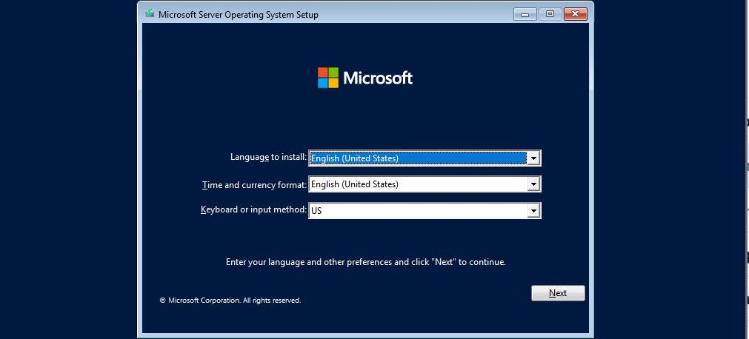
'iie
edit
Vie VM labs Help

Slide 35
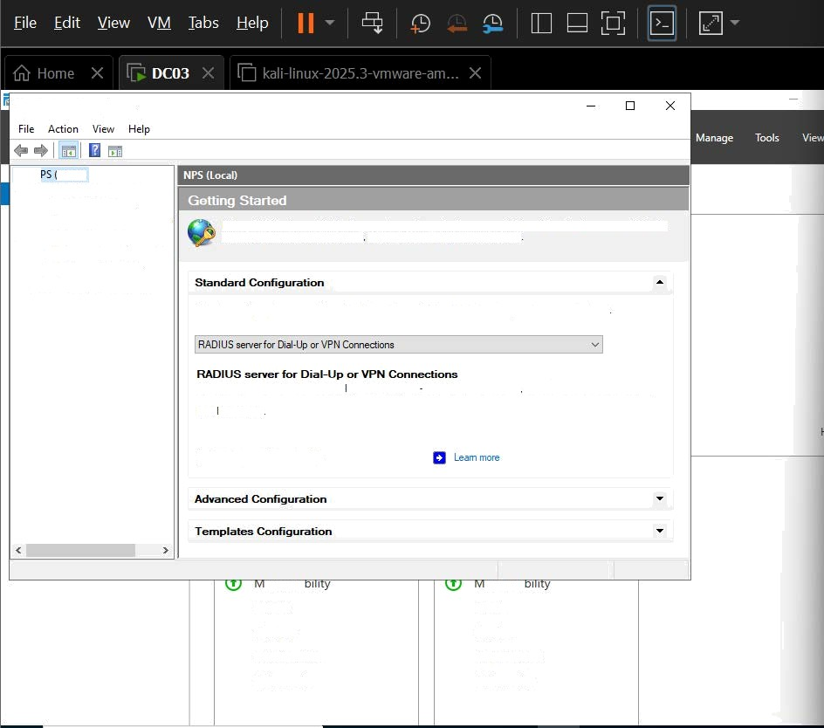
Network Policy Server
N ;LocaI)
RADIUS Clients and Servers
RADIUS Clients
Remote RADIUS Server p olicies
' Connection Request No Network p olicies
Accounting
Templates Management
v
v
Network Policy Server (NPS) allows you to create and enforce organization-wide network access policies for connection request authentication and connection request authorization
SeIeot a configuration scenario from the list and then click the link below to open the scenario wizard
When you configure NPS as a RAD US server for Dial Up or VPN connections you create network policies that allow NPS to authenticate and authorize connections from Dial-Up or VPN network access servers {also called RAD US clients)
Configure VPfJ or Dial-Up
anagea
Events Services Performance BPA results
anagea
Events Services Performance BPA results

Slide 36
To direef inmuI to this VM mo e I he mcrise join tei inside or press čtrl— G.

Slide 37
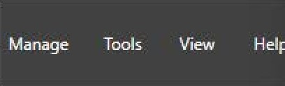

New Network Policy
Configure Authentication f4ethods
Configure *a.° or more auih.°n-tcatisn methods required for the connection request to match this psl'!ry. For ERP authentication, you must configure an ERP g'pe.
.. ..
,
-' EAP tyqes are negotiated between NPS and the client in the order in which they are listed.
ces
S
s U
° U
Microsoft Encrypted Authentication version 2 (MS-CHAP-v2 @ User can change password after it has expired
@ Microsoft En pted Authentication {MS-CHAP)
@ User can change password after it has expired @ Encrypted authentication tCHAP)
@ Unencrypted authentication {PAP, SPAP)
@ .flow clients to connect without negotiating an authentication method.
Previous New
' - -
Cancel
Services Performance BPA r=.sults
Ser/ces
Performance

Slide 38


